Slide 1
Pls 2000 power & politics dr. shannon
CONSTITUTIONS & INSTITUTIONS

Slide 2
CONSTITUTIONS & INSTITUTIONS
I. CONSTITUTIONS
II. INSTITUTIONS
TERMS TO KNOW
Federalism Rule of Law Executive
Unitary System Legislative Checks & Balances
Separation of Powers Presidential System Devolution
Parliamentary System Consociational Democracy Head of State
Head of Government Article I Article II
Delegate & Trustee Models of Representation Layer Cake v. Marble Cake Federalism

Slide 3
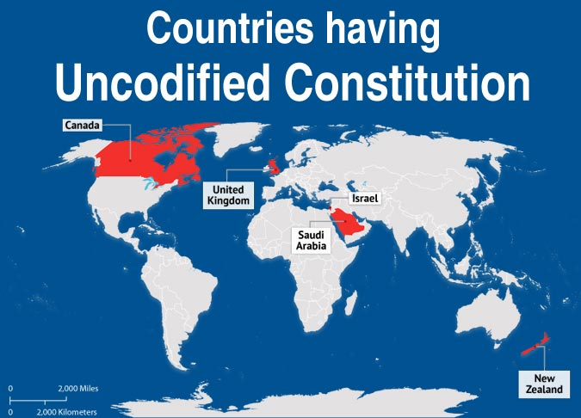
I. CONSTITUTIONS
Rule of Law (p.221)
Laws created to regulate human conduct
Everyone is equal under the law?
Obedience and Safeguards
Constitution
“A specific document that lays down the basic institutions of state and procedures for changing them, as well as the basic rights and obligations of its citizens…
Basic source of national law … individual laws and legal codes are expected to conform to it.” (p.221)

Slide 4
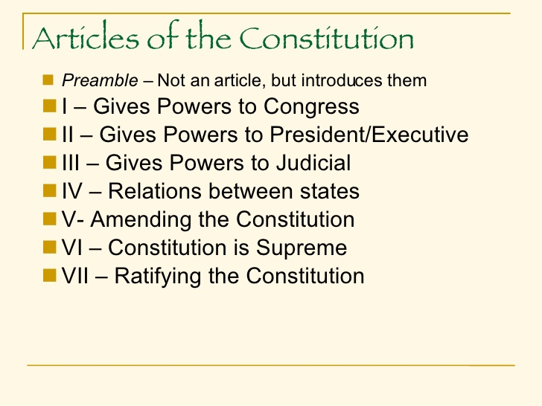
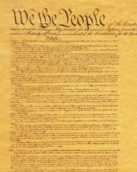
THE U.S. CONSTITUTION
ARTICLE I
Taxation
Creation of military
Declaration of war
Create money
Regulate commerce
Regulate immigration
Impeachment
Ratify treaties
Confirm appointments
ARTICLE II
Commander-in-Chief
Chief Diplomat: Foreign relations and treaty negotiations
Chief Executive: Nominate judges and government officials

Slide 5
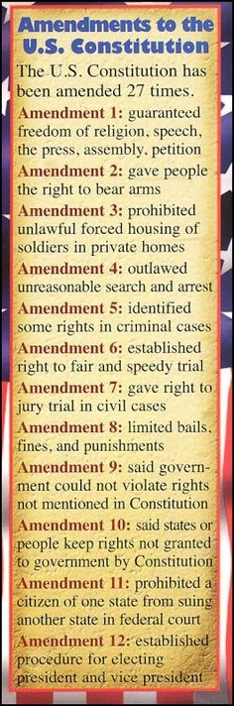
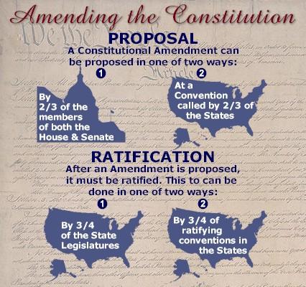
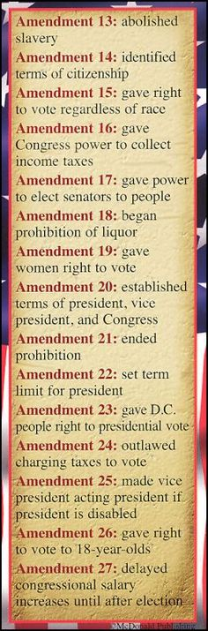
AMENDING THE CONSTITUTION

Slide 6
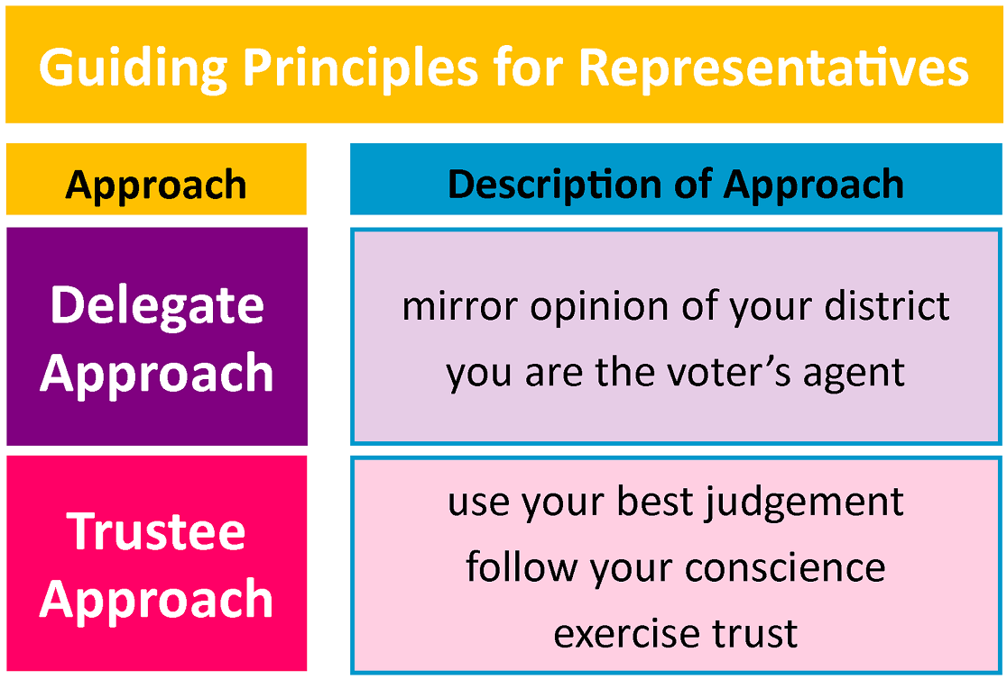
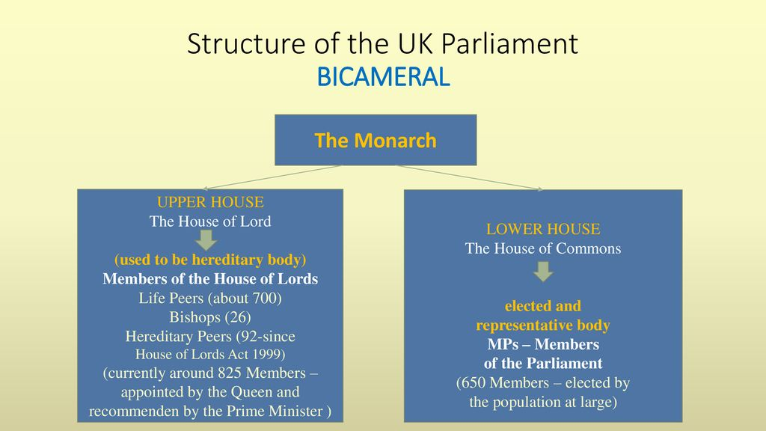
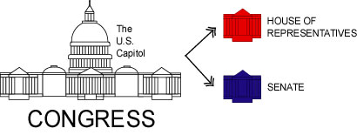
II. INSTITUTIONS
“regular patterns of behavior that provide stability and predictability to social life” (p.163)
Formal: define the rules of the political game… who can play and how they play…they ultimately can shape who wins and who loses” (p.164)
Legislatures
Representatives of the People creating laws for the land
Delegate vs. Trustee Models
Territorial v. National Representation
Equal v. Proportional Representation
Unicameral v. Bicameral
http://www1.curriculum.edu.au/ddunits/guide/g5b_chart.htm
https://courses.lumenlearning.com/americangovernment/chapter/the-legislative-process/

Slide 7
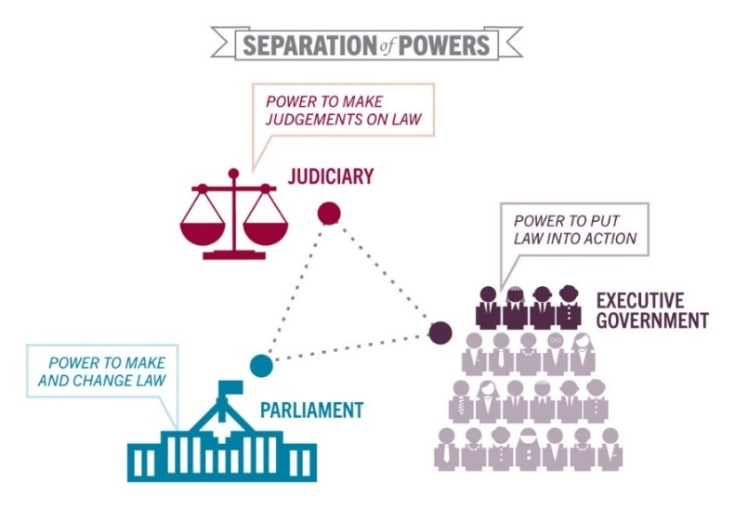
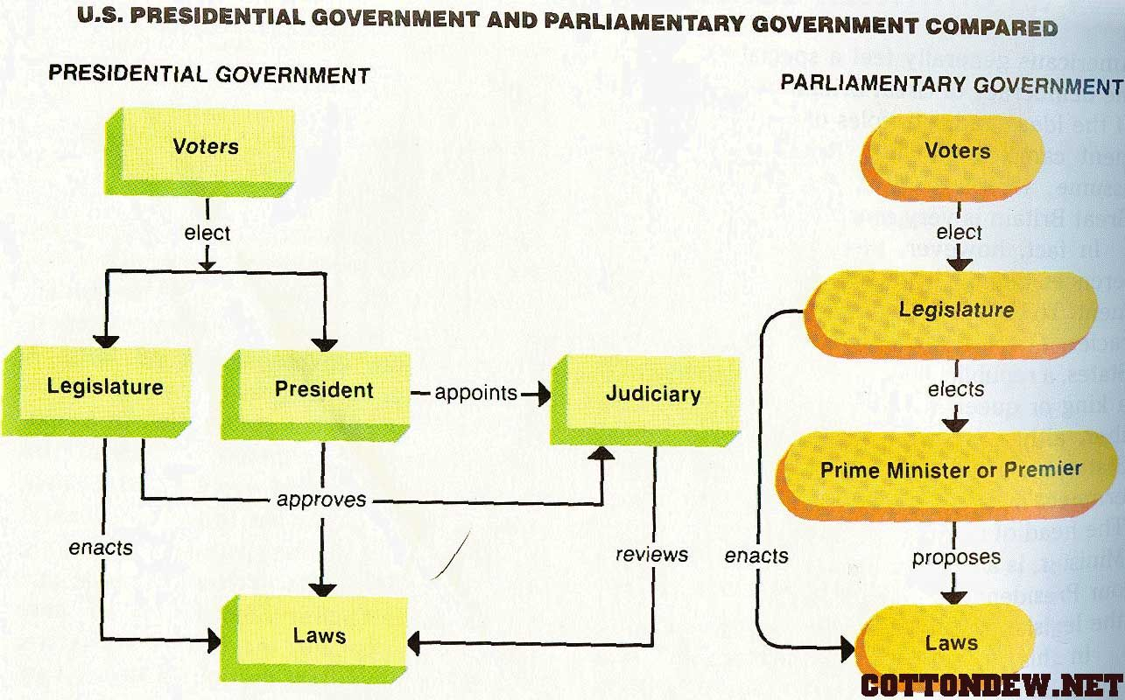
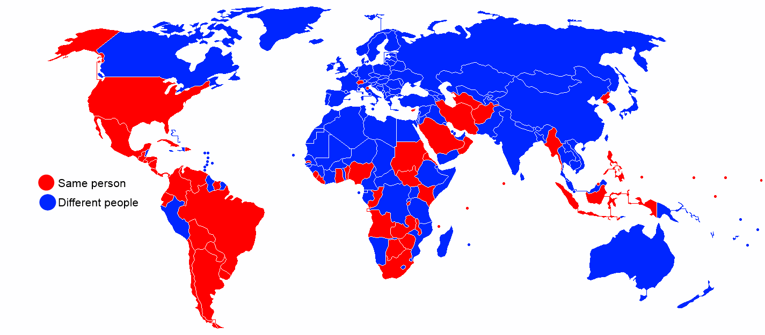
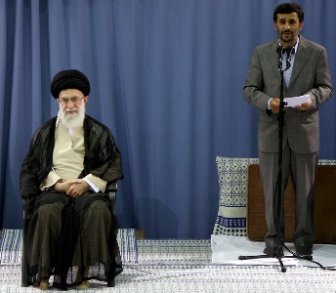
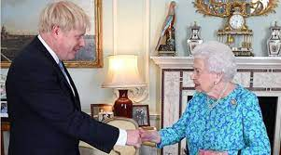
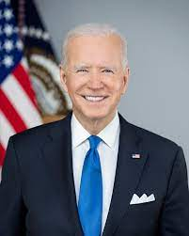
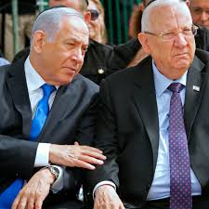
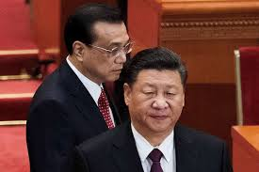
Diffusing power, part I: Separation of powers
Separate offices & functions?
Legislative
Executive
Judicial
PRESIDENTIAL: Strong, independent executive
PARLIAMENTARY: Executive comes from Parliament
Same Person or Different?
Head of State: ceremonial unifying role and national representative
Head of Government: political and party leader for the legislative agenda
https://sites.google.com/site/comparativegovernmentrussia/activities
http://www1.curriculum.edu.au/ddunits/guide/g5b_chart.htm

Slide 8
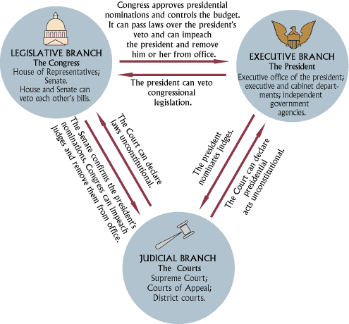
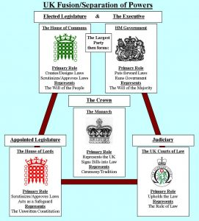
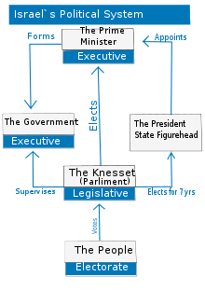
Diffusing power, part I Separation of powers
Separate offices & functions?
Legislative
Executive
Judicial
Checks and Balances
https://www.lawyersnjurists.com/article/separation-of-power-and-uk-constitution/
https://sites.google.com/site/comparativegovernmentrussia/activities
http://www1.curriculum.edu.au/ddunits/guide/g5b_chart.htm

Slide 9
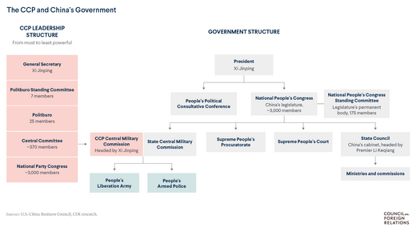
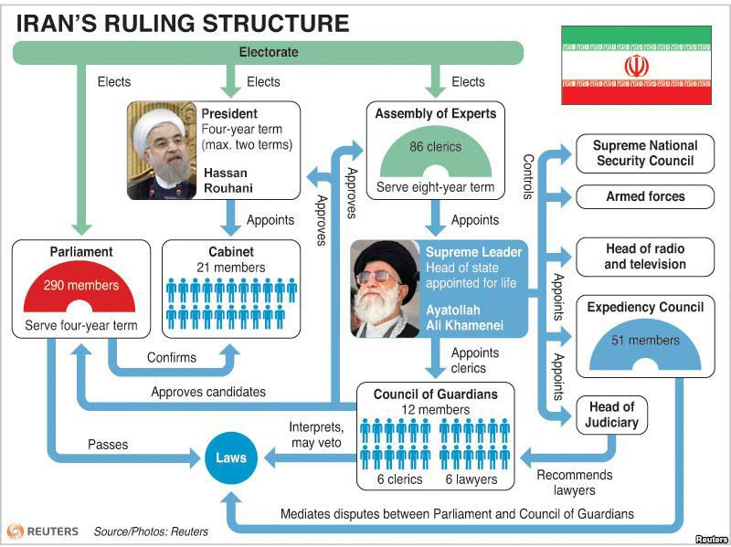
Diffusing power, part I Separation of powers
Separate offices & functions?
Legislative
Executive
Judicial
https://www.lawyersnjurists.com/article/separation-of-power-and-uk-constitution/
https://sites.google.com/site/comparativegovernmentrussia/activities
http://www1.curriculum.edu.au/ddunits/guide/g5b_chart.htm

Slide 10
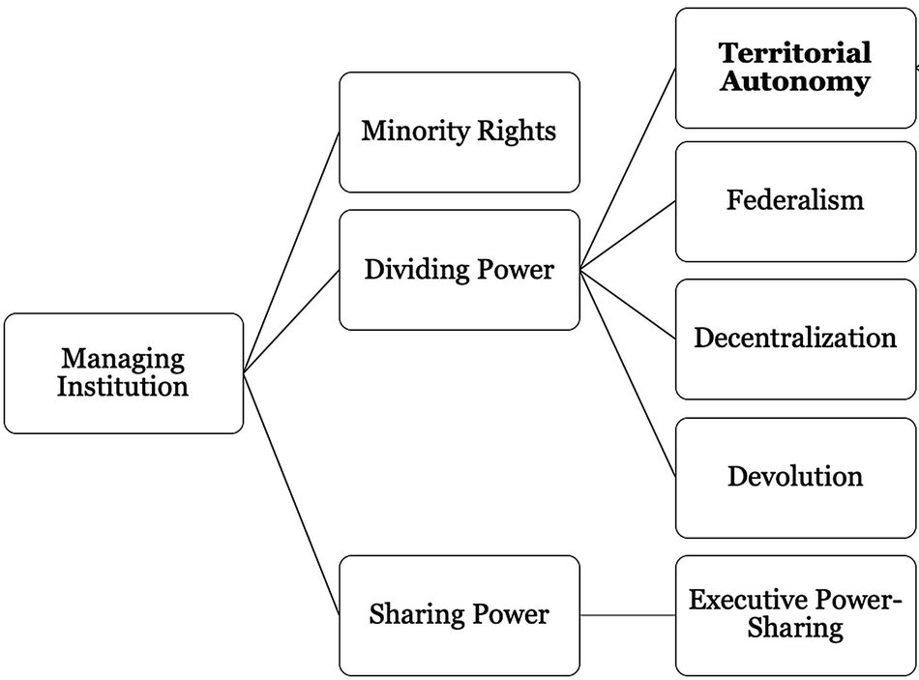
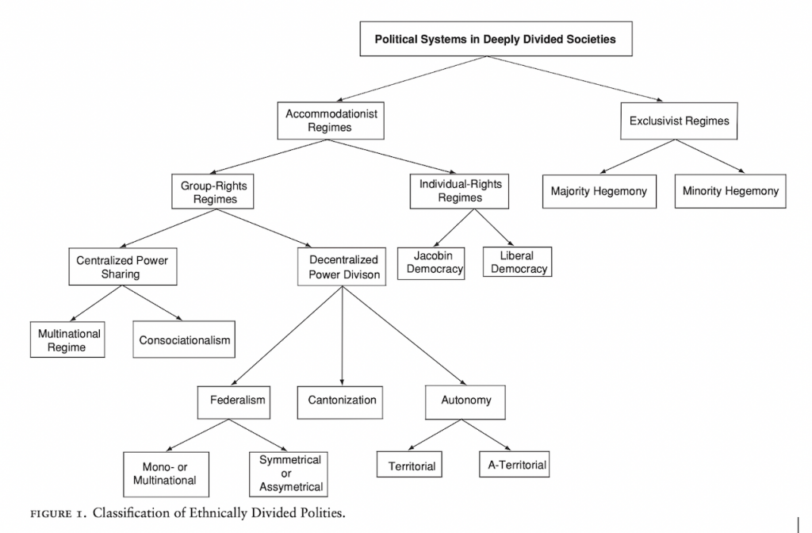
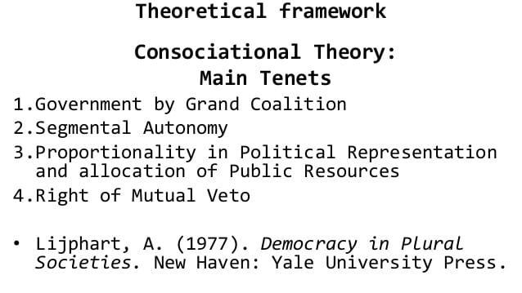
Diffusing power, Part II: federal VS. UNITARY vS. consociational states
Consociationalism (pp. 233-235)
http://new-nato.net/2020/10/25/peleg-i-2007-classifying-multinational-states/
Notes:
Consociationalism: splitting power between factions

Slide 11
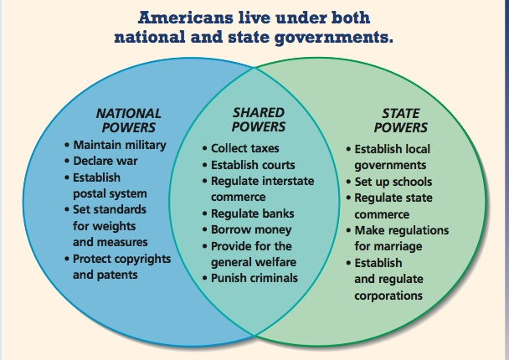
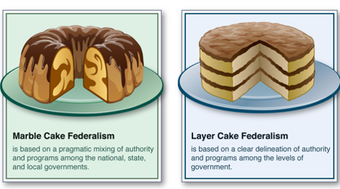
Diffusing power, Part II: federal VS. UNITARY vS. consociational states
Federalism: Taxation, lawmaking and services are shared between national and regional territorial units
http://new-nato.net/2020/10/25/peleg-i-2007-classifying-multinational-states/

Slide 12
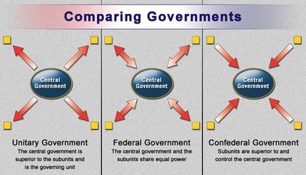
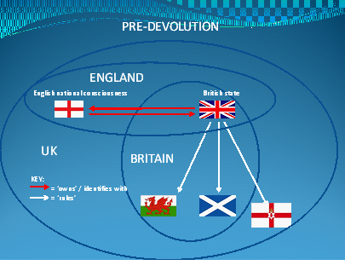
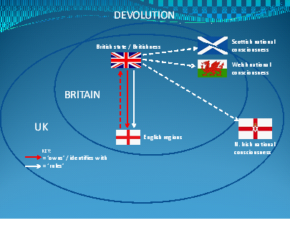
Diffusing power, Part II: federal VS. UNITARY vS. consociational states
Unitary: One central authority creates uniform rules governing all subunits
Devolution: decentralization of power to local and regional governments
England
Scotland
Wales
Northern Ireland
http://smiccompgov.weebly.com/political-culture.html

